Slide 1
Yubiq Studio
Introductory Training Course
Enabling a digital circularity world

Slide 2
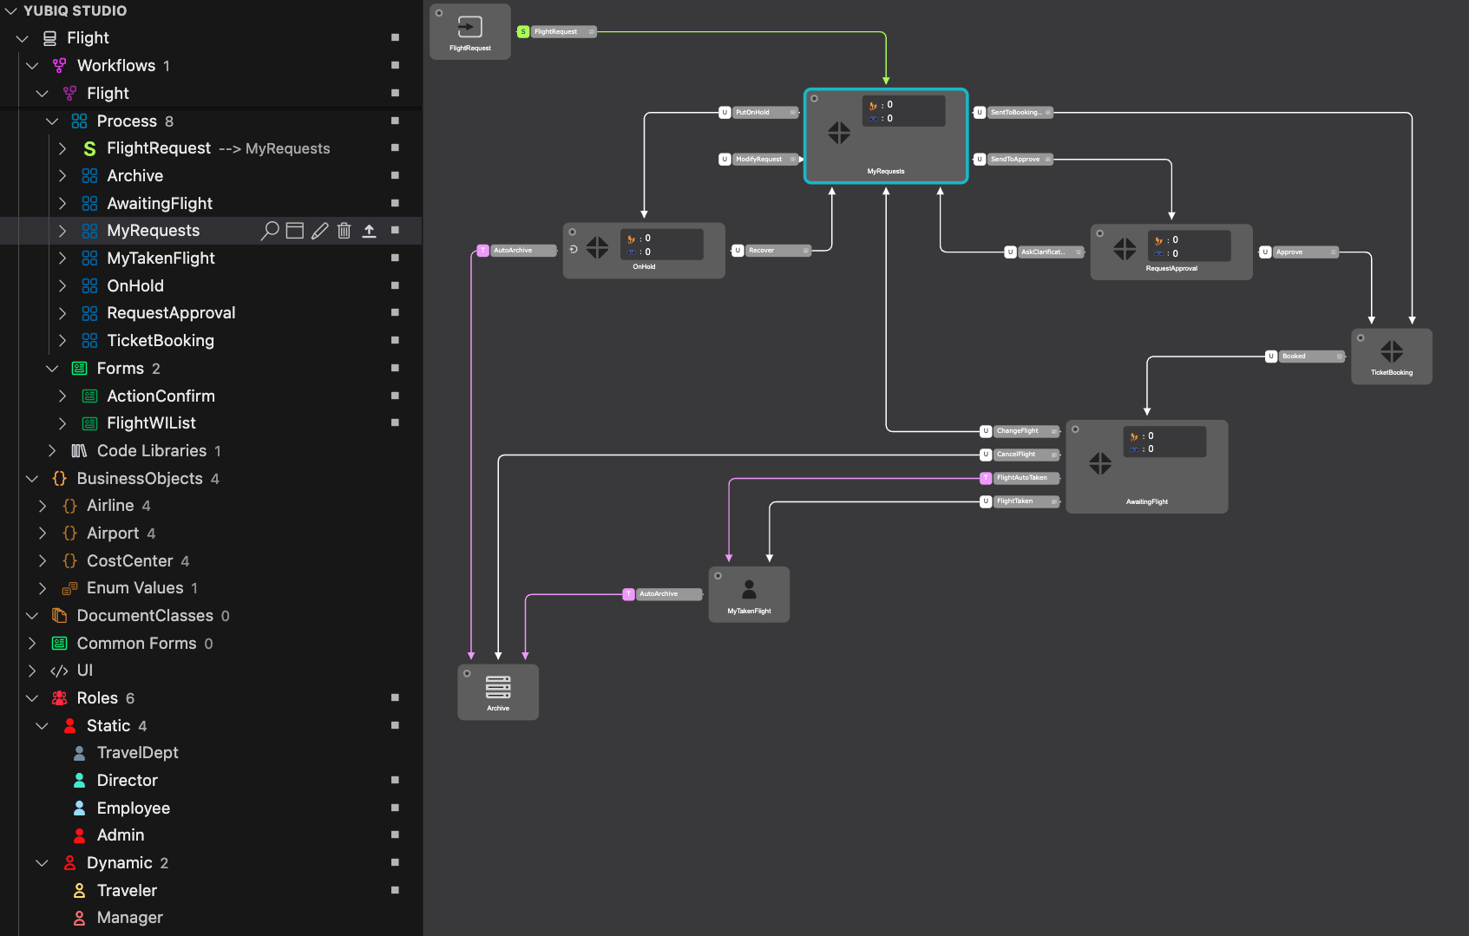
Training agenda
Part 1 | Yubiq BPM solution Overview
Part 2 | Star methodology
Part 3 | Visual Studio Code and Yubiq Studio Installation
Part 4 | The Sandbox
Part 5 | First Modelling (Ticketing process)
Part 6 | First Developing (Ticketing process)
Day 1
Day 2

Slide 3
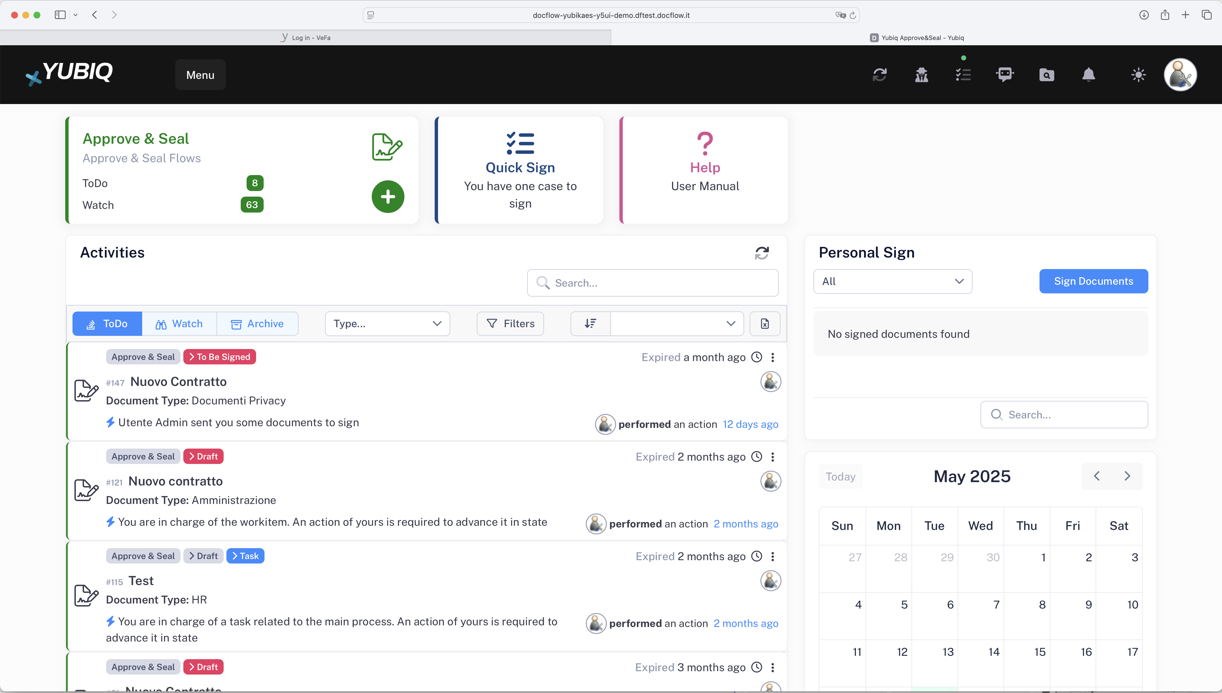
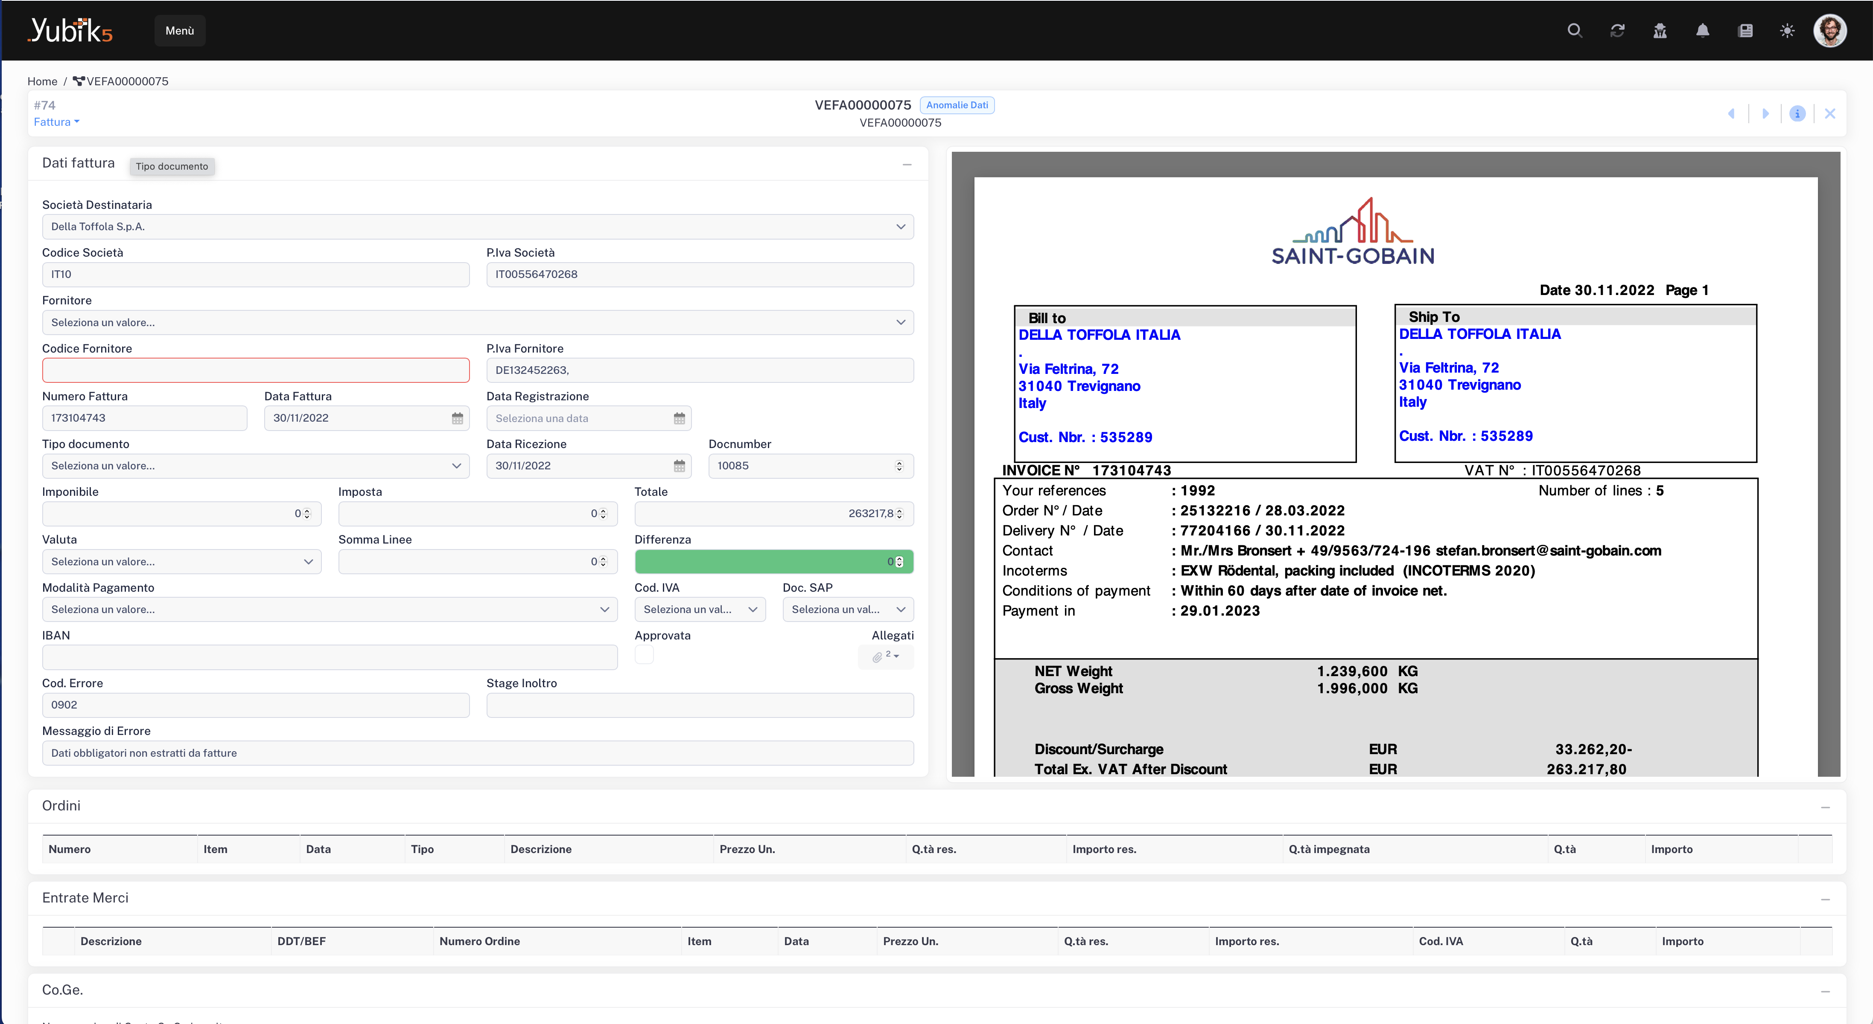
Part 1 : Yubiq BPM Overview
Yubiq is the platform with which we implement process automation solutions. Also called BPM (Business Process Management) or Workflow
Example 1: Yubiq A&S
Example 2: Yubiq ASC

Slide 4
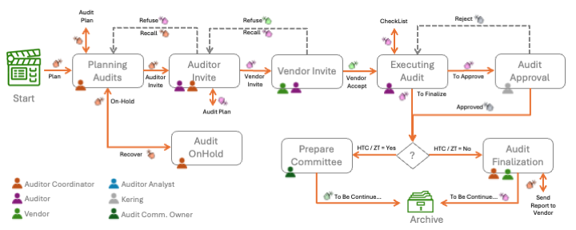
Part 2 : Star Methodology
The STAR (Stages, Action, and Roles) methodology was defined years ago, and is a Business Process Management (BPM) approach aimed at improving the efficiency and effectiveness of business processes.
It represents a structured approach to implementing Business Process Management (BPM).
Stages
Actions
Roles
WorkItem
Business Objects
Forms

Slide 5
Part 2 : Star Methodology :: Ticketing process description
The software support ticket management process is designed to streamline and structure the way support requests are handled within an organization. Built upon the STAR methodology — which stands for Stages, Actions, Roles, and WorkItem — the process ensures that every support request follows a clear, auditable path from its creation to its resolution and eventual closure.
It begins when a customer submits a ticket, typically through a form that captures essential information such as the issue’s title, description, priority, and any relevant attachments. This action initiates the process and places the ticket into the first stage: New Ticket. From here, the request is Took in charge up by a support agent, whose responsibility is to evaluate its content, determine the category of the issue (for example, whether it is software-related, hardware-related, or a network issue), and assign it an appropriate priority level (low, medium, high, or critical).
Once evaluated, the ticket enters the Under Evaluation stage, where the support team may contact the customer for further information if needed. This is where the first interactions begin, and the foundation for resolution is established. When enough information is available, the support agent assigns the ticket to a technician, moving it to the In Progress stage. At this point, a member of the technical team becomes responsible for analysing and solving the problem.
As work progresses, there might be a need for additional feedback or clarification from the customer. In such cases, the ticket moves into the Waiting for Customer stage, pausing the technical work until the required input is received. Once the issue has been addressed and the solution verified by the technician, the ticket is marked as Resolved. However, it is not closed immediately: this provides a final opportunity for the customer to review the solution, test its effectiveness, or raise further questions.
After a predefined period or following explicit customer confirmation, the ticket moves into the Closed stage. This marks the end of the lifecycle for the support request. Every ticket, treated as a WorkItem, carries with it a full history of actions taken, timestamps, the individuals involved, and all related content such as attachments and comments.
Underpinning the entire system are various Business Objects. These include representations of customers and technicians, categorized types of issues, and enumerated priority levels. They ensure data consistency, enable dynamic assignment of tasks, and facilitate reporting and analytics.
All interactions within the process are facilitated through purpose-built forms, tailored for each role and stage. Customers use an intuitive form to submit tickets, support agents work with classification and assignment interfaces, and technicians fill out resolution forms to document their work. In some implementations, a feedback form is also provided to collect customer satisfaction data and improve service quality.
This process, when implemented with tools like Yubiq Studio, allows for both no-code configuration for business analysts and deep customization by developers. It fosters collaboration, traceability, and service excellence, ensuring that technical issues are addressed promptly, effectively, and transparently.

Slide 6
Part 2 : Star Methodology :: Ticketing
This document describes the support ticket management process for software solutions, based on the STAR methodology (Stages, Actions, Roles) and using Yubiq Studio (YS). The process covers the full ticket lifecycle, from creation to closure, enabling tracking, collaboration, and automation.
Stages
New Ticket: Request is created by the user.
Under Evaluation: Support team evaluates the request.
In Progress: The ticket is assigned to a developer or technician.
Waiting for Customer: Awaiting customer feedback or confirmation.
Resolved: The ticket has been addressed and resolved.
Closed: The ticket is permanently closed.
Actions
Create Ticket
Assign Technician
Request Information
Update Status
Mark as Resolved
Close Ticket
Roles
Customer: End user who reports the issue.
Support: Operator who evaluates the request.
Technician: Specialist responsible for solving the issue.
Admin: Has full visibility and permissions across the process
WorkItem
Id (unique)
Title
Description
Priority
Status
Open Date
Close Date
Assignee
Customer
Attachments
Business Objects
Customer: Contains user info (ID, Name, Email, Company).
Technician: List of available technicians (ID, Name, Skills).
Category: Type of issue (Software, Hardware, Network, etc).
Priority: Enum with values (Low, Medium, High, Critical).
Forms
TicketForm: Enter issue details by the customer.
EvaluationForm: Allows support to classify and assign the ticket.
ResolutionForm: Allows technician to document the fix and mark as resolved.
FeedbackForm: Optional, allows customer to provide feedback.

Slide 7





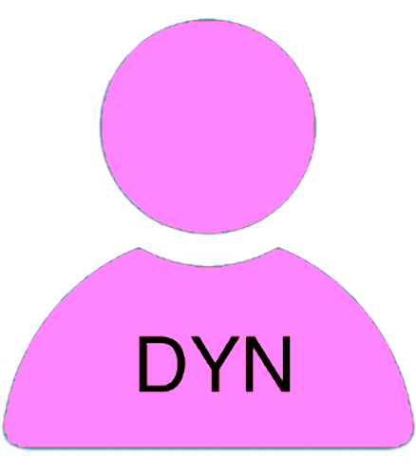


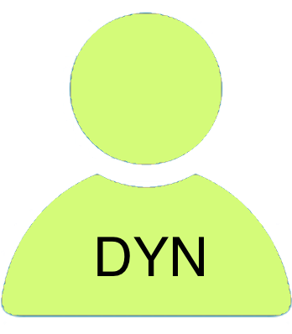




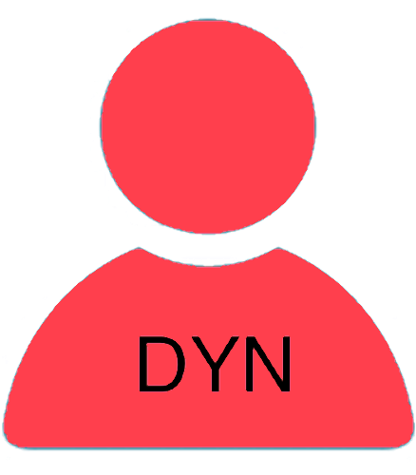


Part 2 : Star Methodology :: Design page !
Start Stage
Archive Stage
Stage
Static Role 1
Dynamic Role 1
Watch
ToDo
Form 1
User Action
Static Role 2
Dynamic Role 2
Form 2
Conditional Action
Static Role 3
Dynamic Role 3
Archive Stage
Form 3
Timed Action
Start Stage

Slide 8

Part 2 : Star Methodology :: Ticketing Process example
Auto Release
Escalate
New Tickets
My Tickets
My Tickets
More Stages
Watch
Watch
Dispatch
Watch
Watch
Create Ticket
ToDo
Take in Charge
ToDo
ToDo
To Be Continue
ToDo
Start Stage
Auto
Dispatch
Cancel Ticket
Ask
Clarif.
Respond
Evaluate
My Tickets
Watch
Respond
ToDo
Archive Stage
Customer
Originator
User Action
Confirm
Support
Ass. Support
Conditional Action
Create
Technician
Ass. Technician
Timed Action
Evaluate

Slide 9
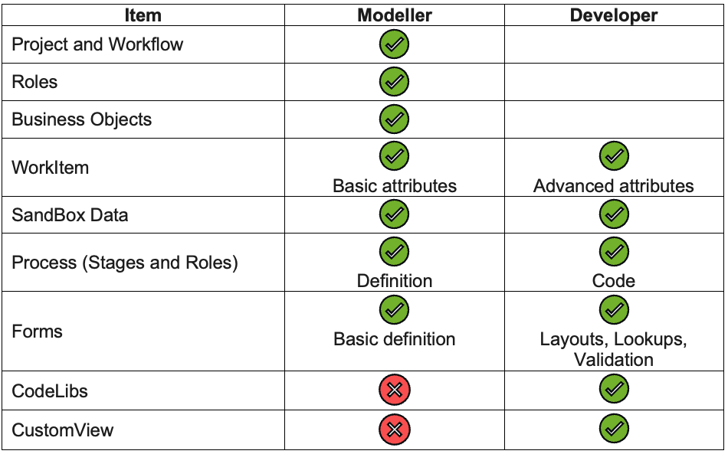

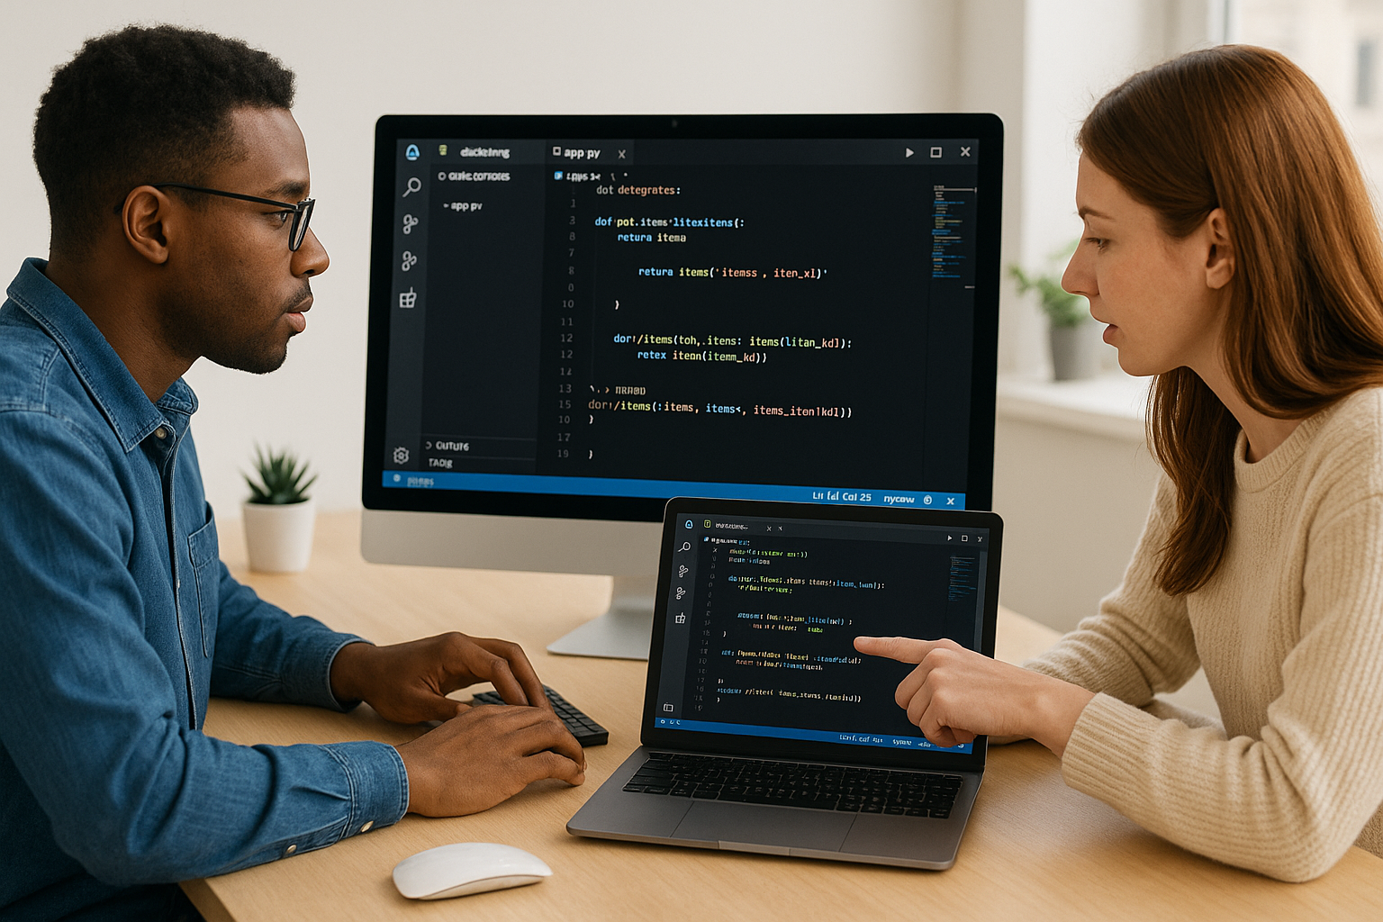
Part 2 : Star Methodology :: Design Vs Developing

Slide 10

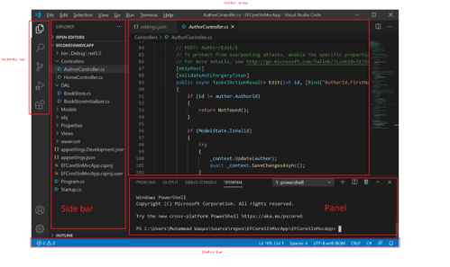
Part 3 : VSC & YS Installation
Yubiq Studio is based entirely on Visual Studio Code, (VSC or vscode), is a free source code editor developed by Microsoft for Windows, macOS and Linux. Features include debugging, syntax highlighting, intelligent code completion, snippets, code refactoring, and built-in version control with Git. With nearly 75 percent market share and 14 million users, VSCode is the most popular IDE available (source Wikipedia).
Because VSC is a generic IDE there are over 30,000 extensions in its store that allow you to customize virtually anything in the IDE. YS is formally a Visual Studio Code extension, which can be downloaded and installed from the Microsoft store.

Slide 11
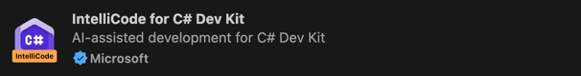
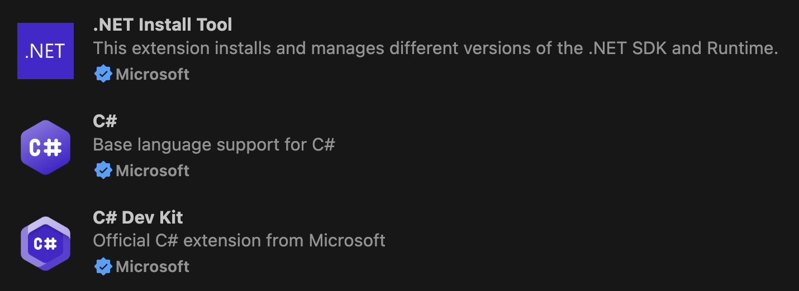

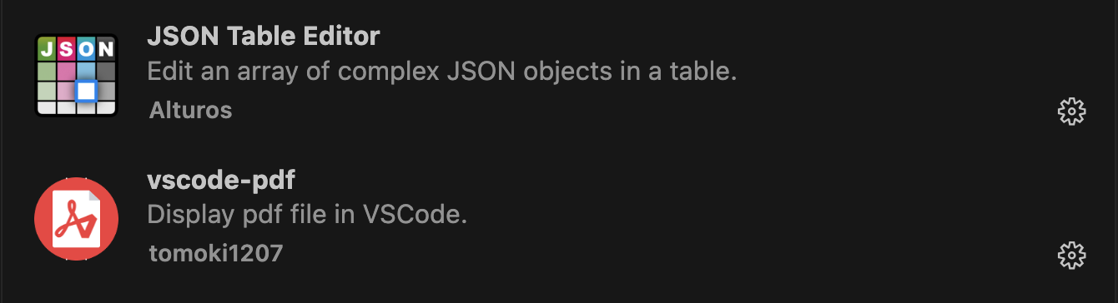
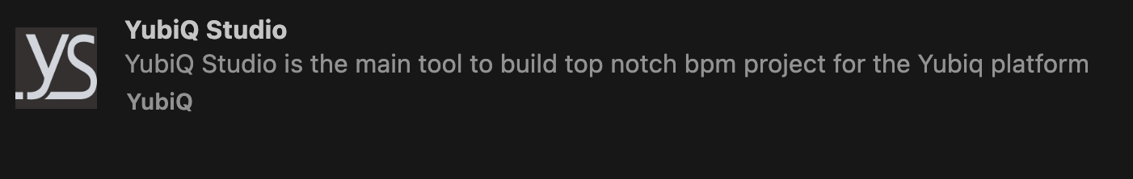
Part 3 : VSC & YS Installation
Once you have installed VSC on a Windows or MAC environment (Linux is not supported at the moment) proceed with the installation of the .NET 8 SDK: https://dotnet.microsoft.com/en-us/download/dotnet/8.0
And thus, of the following extensions of VSC. Microsoft .NET C#: The basic extensions of .NET C# development.
GitHub Copilot: For adding AI during development. Strongly recommended especially if you have a full user license!
Utility extensions: We also recommend installing the following extensions that provide useful functionality during development:
Yubiq Studio: Finally, we install the extension for Yubiq Studio!

Slide 12
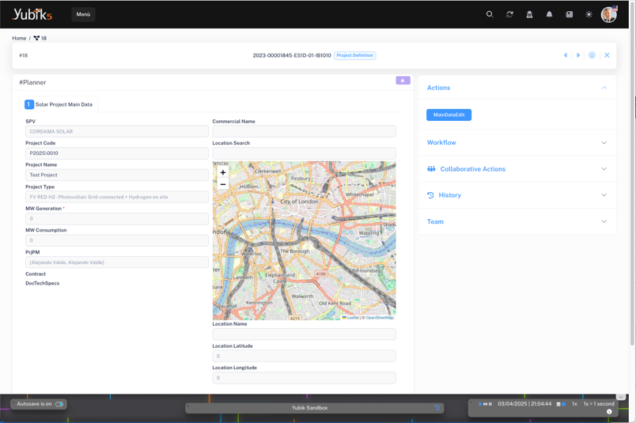
Part 4 : The SandBox
The SandBox is an isolated executing environment that allows a project to be simulated and tested without affecting the actual production system. This tool is essential for the initial phase of development, as it allows you to work on various aspects of the project, such as analysis, flow modeling, creation of ancillary data structures, and design of interaction forms. In addition, all code that does not depend on the Yubiq production environment can be written and tested in the SandBox.
Using the SandBox, about 90 percent of the design can be done locally, thus providing greater efficiency and speed in the development phase. Prototype demonstration phases to the customer can also be carried out through the SandBox, which can be made "portable" to facilitate presentations in different contexts.
Another advantage of the SandBox environment is the ability to use simulated execution data to test the operation of the project. This allows you to verify proper integration and interaction between the various components of the system before moving on to the production phase.
Launch the SandBox locally on your Browser at any time during solution development. Great for constant testing and local debugging
Export a ZIP file with the SandBox to run on any Windows or Mac client.
Publish the SandBox on the "SandBox Server" so that anyone in possession of the link can run it.

Slide 13
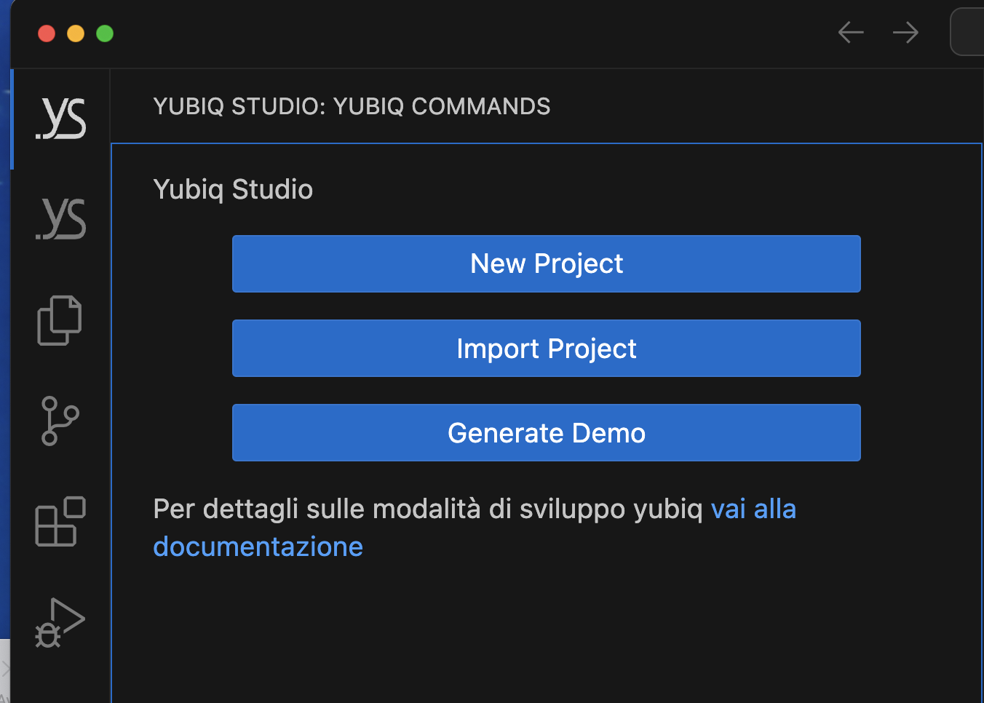
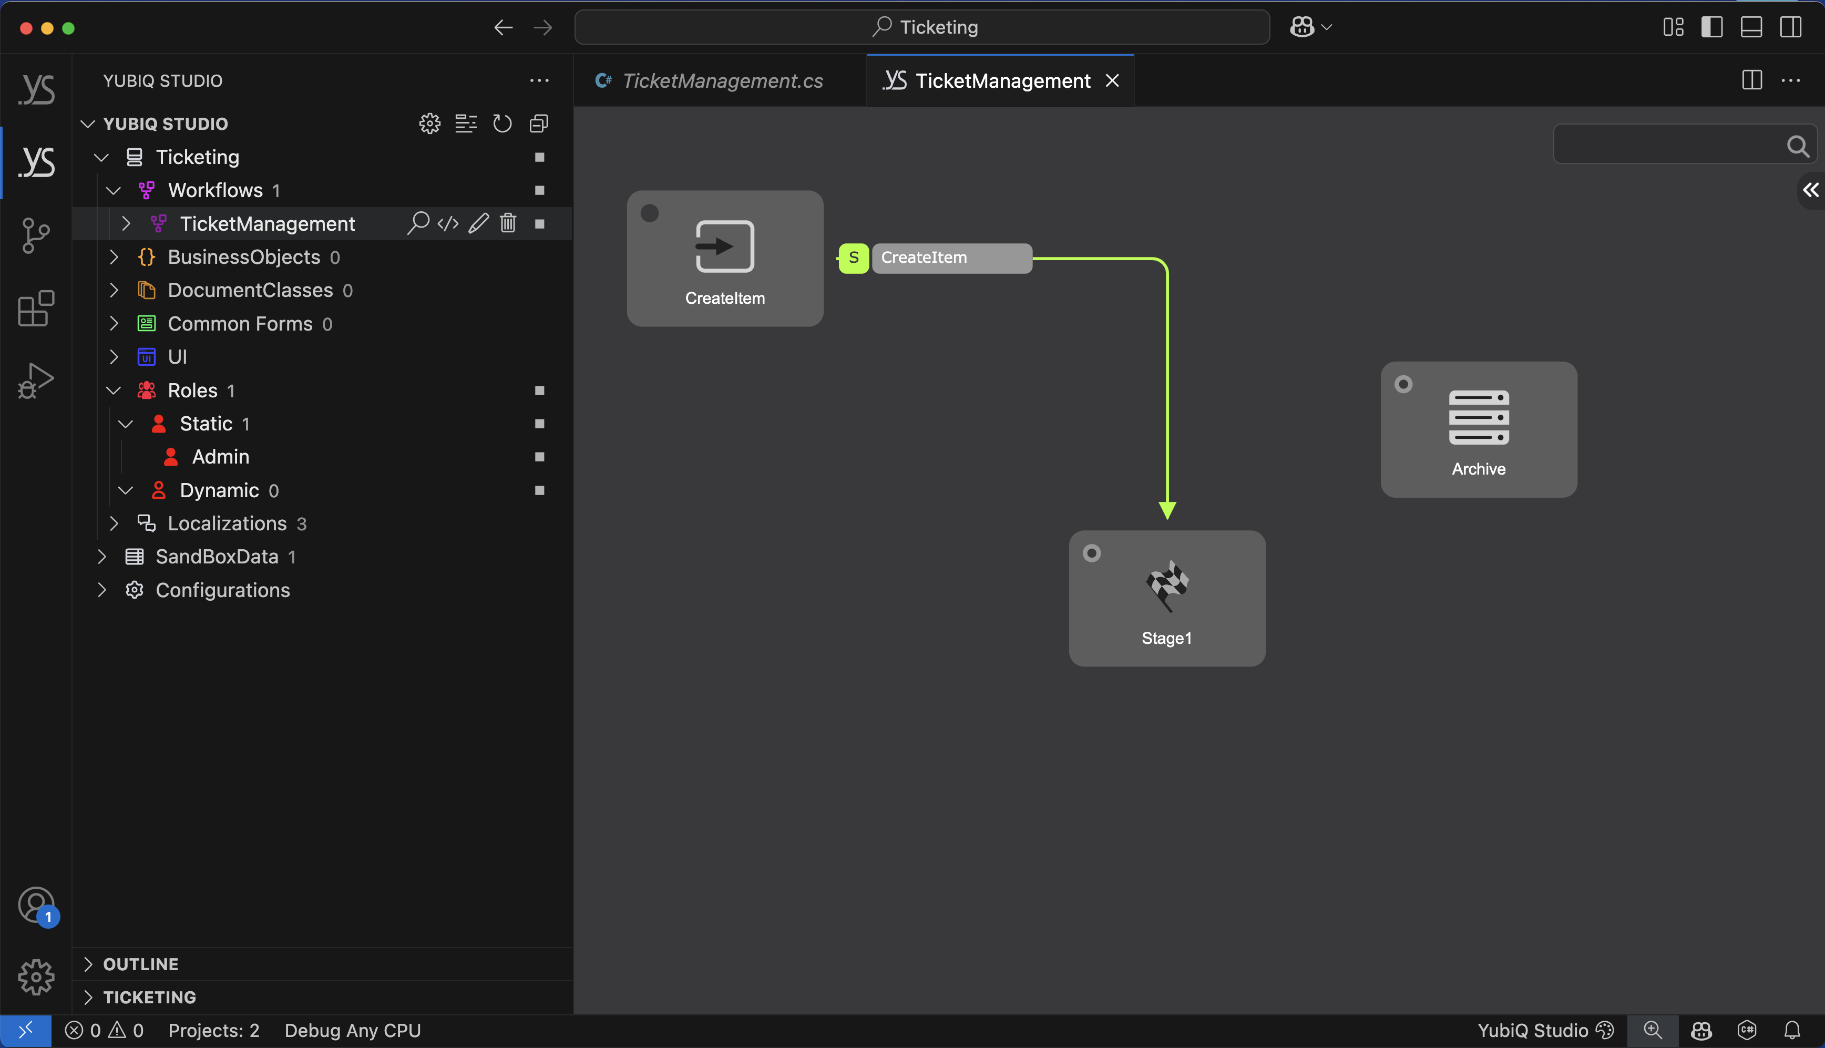
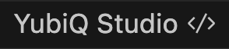

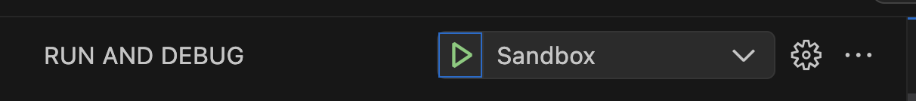
Part 5 : First Modelling :: Workflow
2) New Project
New Project: Ticketing
New Workflow: TicketManagement
3) Click to open the graphic Map of the Process
Developer mode
Design mode
At anytime you can launch the solution in the SandBox !
1) Activate Design mode

Slide 14
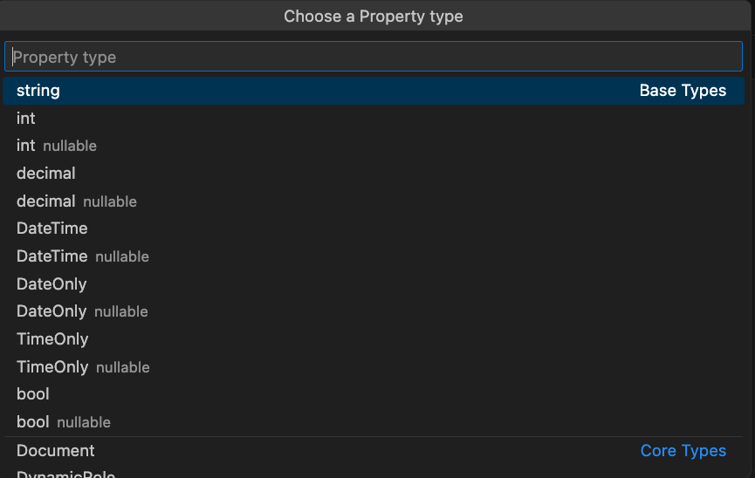
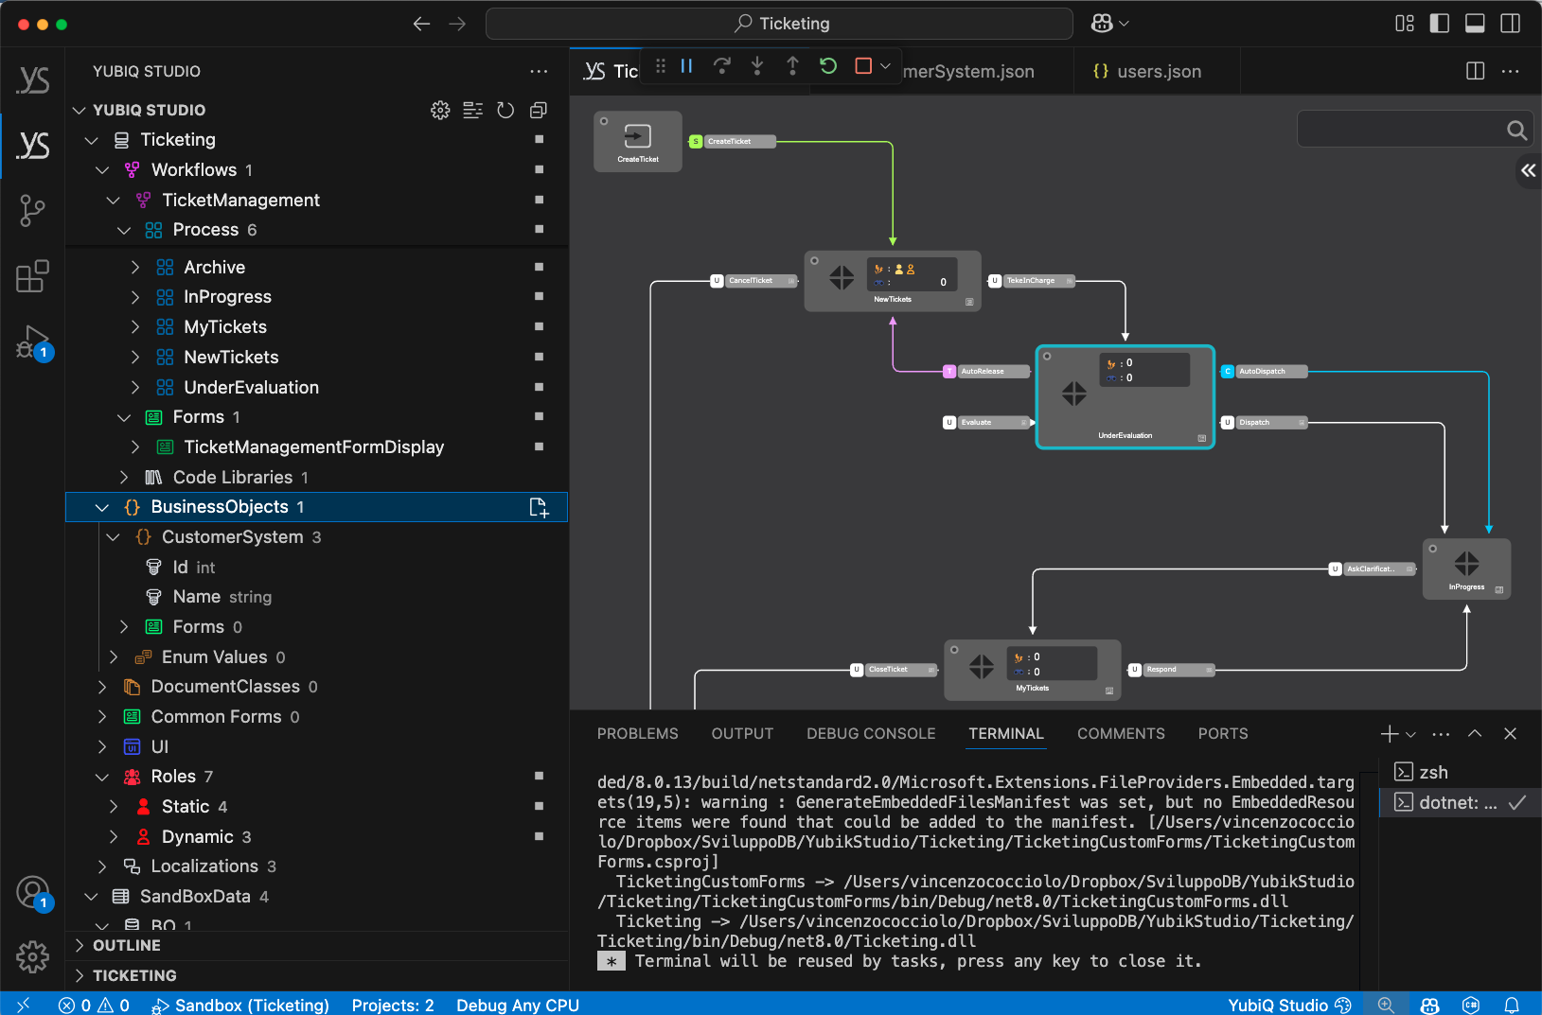
Part 5 : First Modelling :: Business Object
New Business Object: CustomerSystem
Add Field: string Name
Create the CustomSystem BO
Add the Name string Field

Slide 15
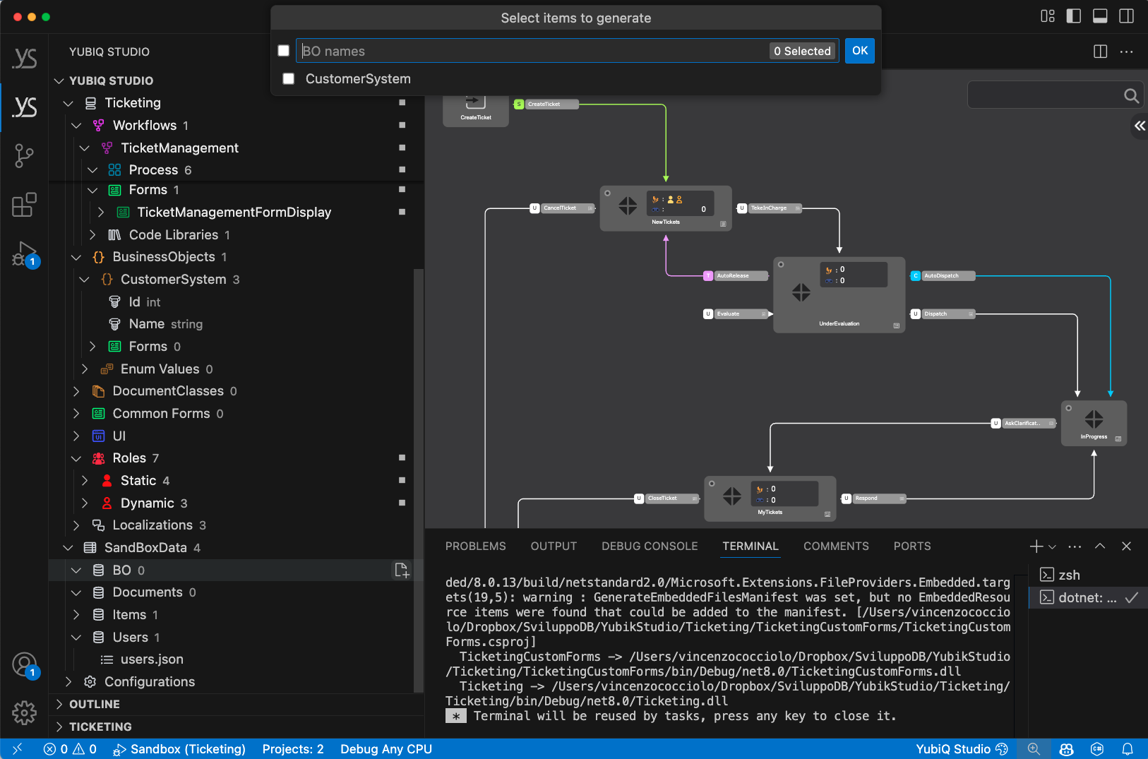
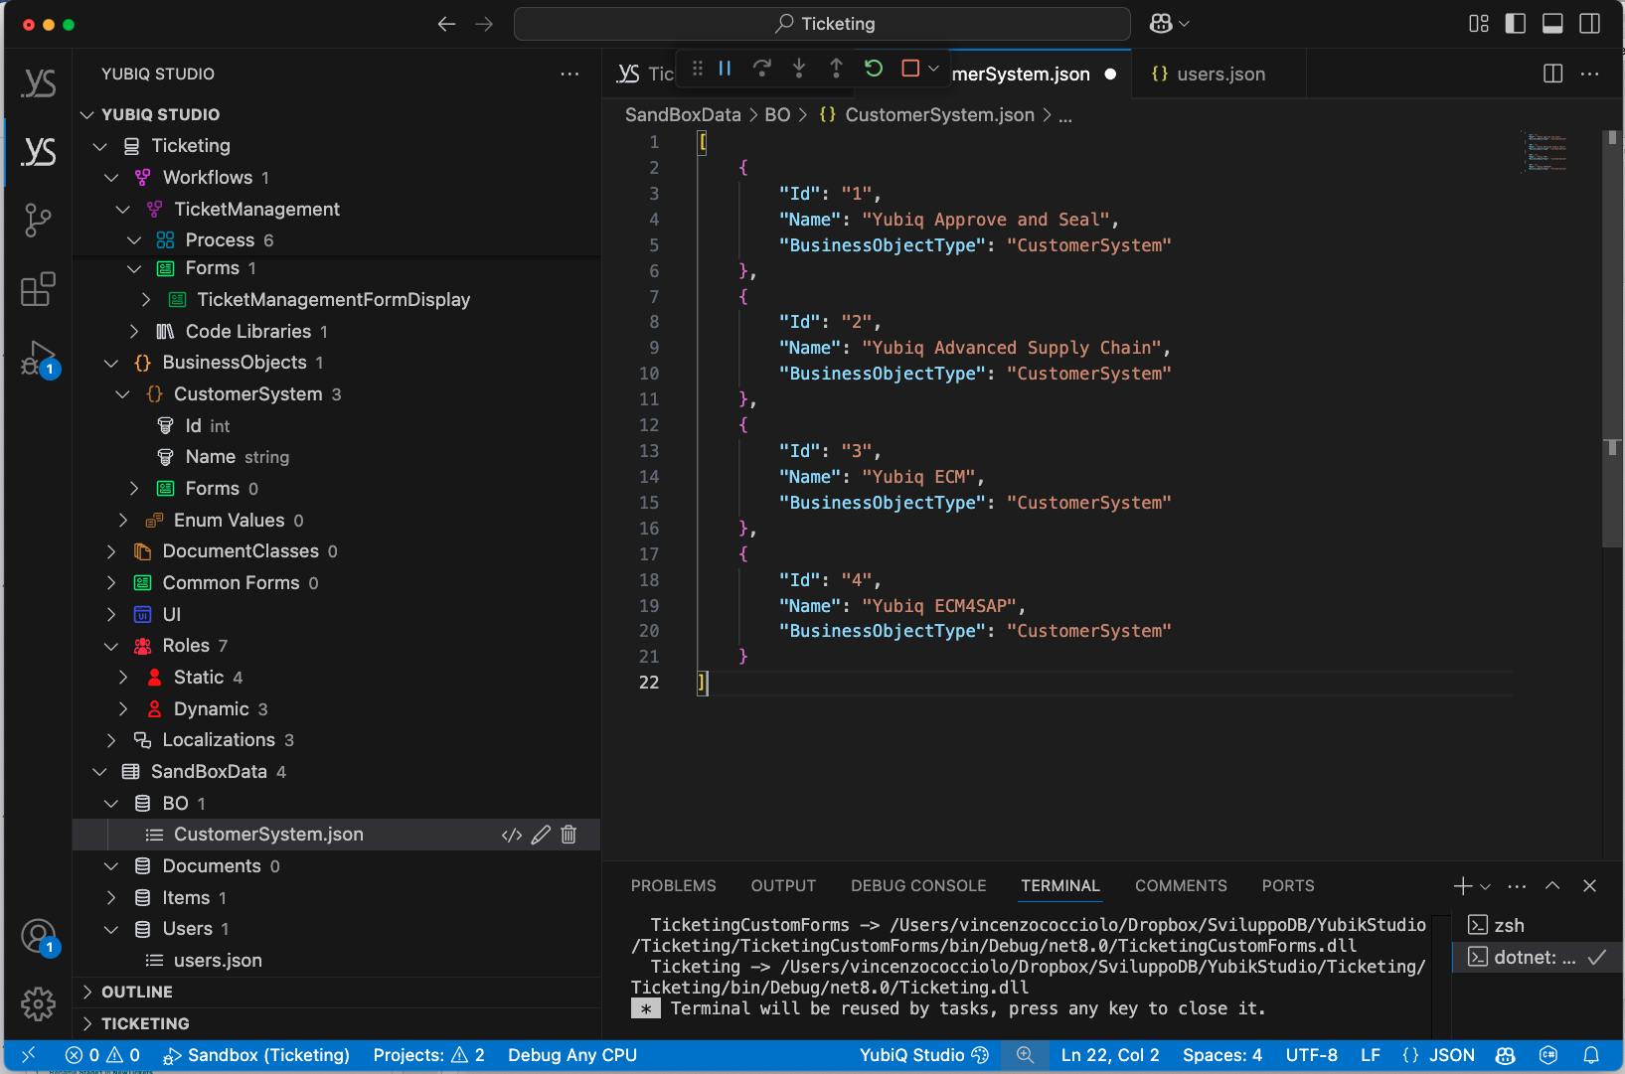
Part 5 : First Modelling :: SandBox Data → BO
2) Choose the BusinessObject to create
1) Press [+] to create the BO Json file
[
{
"Id": "1",
"Name": "Yubiq Approve and Seal",
"BusinessObjectType": "CustomerSystem"
},
{
"Id": "2",
"Name": "Yubiq Advanced Supply Chain",
"BusinessObjectType": "CustomerSystem"
},
{
"Id": "3",
"Name": "Yubiq ECM",
"BusinessObjectType": "CustomerSystem"
},
{
"Id": "4",
"Name": "Yubiq ECM4SAP",
"BusinessObjectType": "CustomerSystem"
}
]
3) With </> edit the Json File to add the elements in the text area on the left

Slide 16
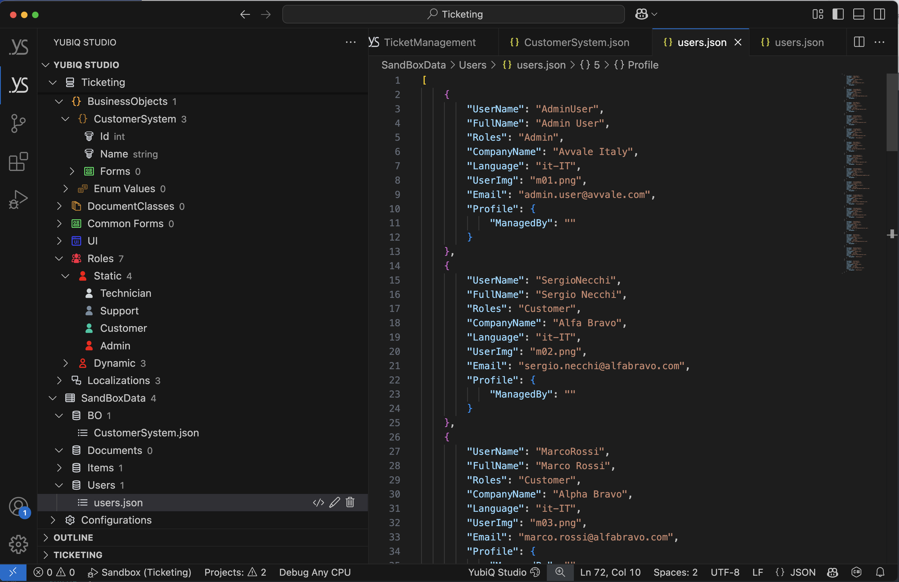
Part 5 : First Modelling :: SandBox Data → Users
[
{
"UserName": "AdminUser",
"FullName": "Admin User",
"Roles": "Admin",
"CompanyName": "Avvale Italy",
"Language": "it-IT",
"UserImg": "m1.png",
"Email": "admin.user@avvale.com",
"Profile": {
"ManagedBy": ""
}
},
{
"UserName": "SergioNecchi",
"FullName": "Sergio Necchi",
"Roles": "Customer",
"CompanyName": "Alfa Bravo",
"Language": "it-IT",
"UserImg": "m2.png",
"Email": "sergio.necchi@alfabravo.com",
"Profile": {
"ManagedBy": ""
}
},
{
"UserName": "MarcoRossi",
"FullName": "Marco Rossi",
"Roles": "Customer",
"CompanyName": "Alpha Bravo",
"Language": "it-IT",
"UserImg": "m3.png",
"Email": "marco.rossi@alfabravo.com",
"Profile": {
"ManagedBy": ""
}
},
{
"UserName": "AntonioScotti",
"FullName": "Antonio Scotti",
"Roles": "Support",
"CompanyName": "Avvale Italy",
"Language": "it-IT",
"UserImg": "m4.png",
"Email": "antonio.scotti@avvale.com",
"Profile": {
"ManagedBy": ""
}
},
{
"UserName": "LuigiBianchi",
"FullName": "Luigi Bianchi",
"Roles": "Support",
"CompanyName": "Avvale Italy",
"Language": "it-IT",
"UserImg": "m5.png",
"Email": "luigi.bianchi@avvale.com",
"Profile": {
"ManagedBy": "MarinaRossi"
}
},
{
"UserName": "MarinaRossi",
"FullName": "Marina Rossi",
"Roles": "Technician",
"CompanyName": "Avvale Italy",
"Language": "it-IT",
"UserImg": "f1.png",
"Email": "marina.rossi@avvale.com",
"Profile": {
"ManagedBy": ""
}
},
{
"UserName": "EnricoNardelli",
"FullName": "Enrico Nardelli",
"Roles": "Technician",
"CompanyName": "Avvale Italy",
"Language": "it-IT",
"UserImg": "m6.png",
"Email": "enrico.nardelli@avvale.com",
"Profile": {
"ManagedBy": "MarinaRossi"
}
},
{
"UserName": "FelipeJimenez",
"FullName": "Felipe Jimenez",
"Roles": "Customer",
"CompanyName": "Charlie Delta",
"Language": "es-ES",
"UserImg": "m7.png",
"Email": "felipe.jimenez@charliedelta.com",
"Profile": {
"ManagedBy": ""
}
},
{
"UserName": "AlejandoBalde",
"FullName": "Alejando Balde",
"Roles": "Customer",
"CompanyName": "Charlie Delta",
"Language": "es-ES",
"UserImg": "m8.png",
"Email": "alejando.balde@charliedelta.com",
"Profile": {
"ManagedBy": ""
}
},
{
"UserName": "IsabellaNavarro",
"FullName": "Isabella Navarro",
"Roles": "Support",
"CompanyName": "Avvale Spain",
"Language": "es-ES",
"UserImg": "f2.png",
"Email": "isabella.navarro@avvale.com",
"Profile": {
"ManagedBy": "AlejandoBalde"
}
},
{
"UserName": "SofiaGonzalez",
"FullName": "Sofia Gonzalez",
"Roles": "Technician",
"CompanyName": "Avvale Spain",
"Language": "es-ES",
"UserImg": "f3.png",
"Email": "sofia.gonzales@avvale.com",
"Profile": {
"ManagedBy": "AlejandoBalde"
}
},
{
"UserName": "DonaldVance",
"FullName": "Donald Vance",
"Roles": "Customer",
"CompanyName": "Avvale USA",
"Language": "us-EN",
"UserImg": "m9.png",
"Email": "marina.rossi@echofoxtrot.com",
"Profile": {
"ManagedBy": ""
}
},
{
"UserName": "MattTurner",
"FullName": "Matt Turner",
"Roles": "Customer",
"CompanyName": "Echo Foxtrot",
"Language": "us-EN",
"UserImg": "m10.png",
"Email": "matt.turner@echofoxtrot.com",
"Profile": {
"ManagedBy": ""
}
},
{
"UserName": "BarbaraTaylor",
"FullName": "Barbara Taylor",
"Roles": "Support",
"CompanyName": "Avvale USA",
"Language": "us-EN",
"UserImg": "f4.png",
"Email": "barbara.taylor@avvale.com",
"Profile": {
"ManagedBy": "MattTurner"
}
},
{
"UserName": "WillSmith",
"FullName": "Will Smith",
"Roles": "Technician",
"CompanyName": "Avvale USA",
"Language": "us-EN",
"UserImg": "m11.png",
"Email": "will.smith@avvale.com",
"Profile": {
"ManagedBy": "MattTurner"
}
}
]
]
3) With </> edit the Json and sostituite the content with the Text you see on the right
1) Locate the users.json file in the SandBoxData branch
3) Right Click and ”Format Document”

Slide 17
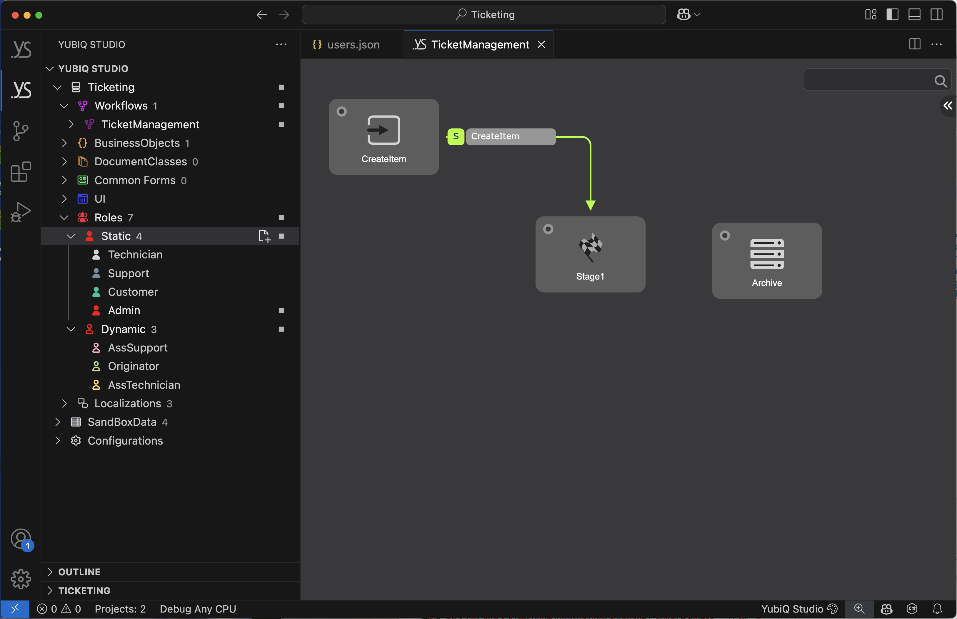
Part 5 : First Modelling :: Roles
Directly on the Yubiq Studio Tree, locate the Roles section, then the Static branch and create three Roles: Customer, Support, Technician
On the Dynamic branch create three other Roles: Originator, AssSupport, AssTechnician
Each Role has a different colour
Dynamic Roles have the Icon empty!

Slide 18
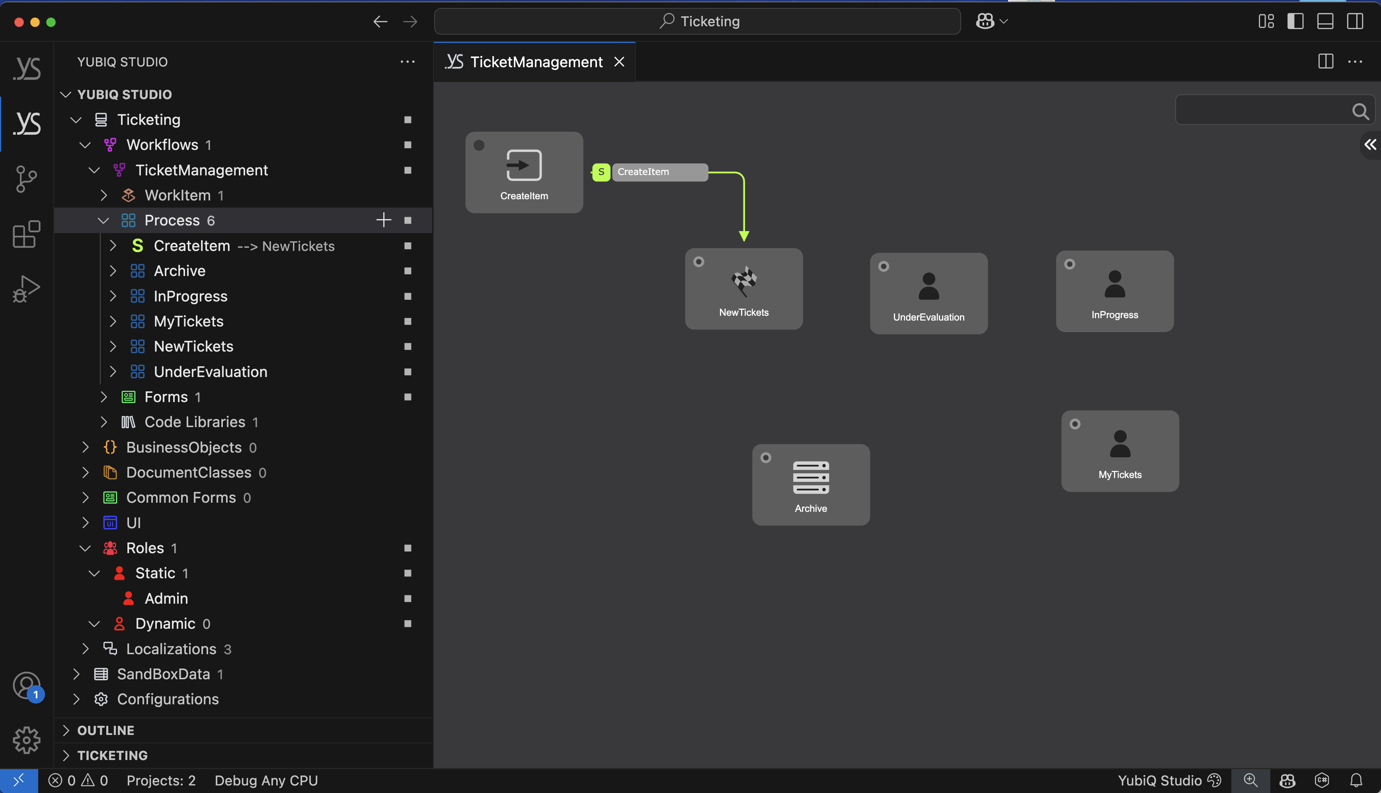
Part 5 : First Modelling :: Stages
Rename Action CreateItem in CreateTicket
Rename Stage1 in NewTickets
Create stage UnderEvaluation
Create stage InProgress
Create stage MyTickets
Create stage MoreStages

Slide 19
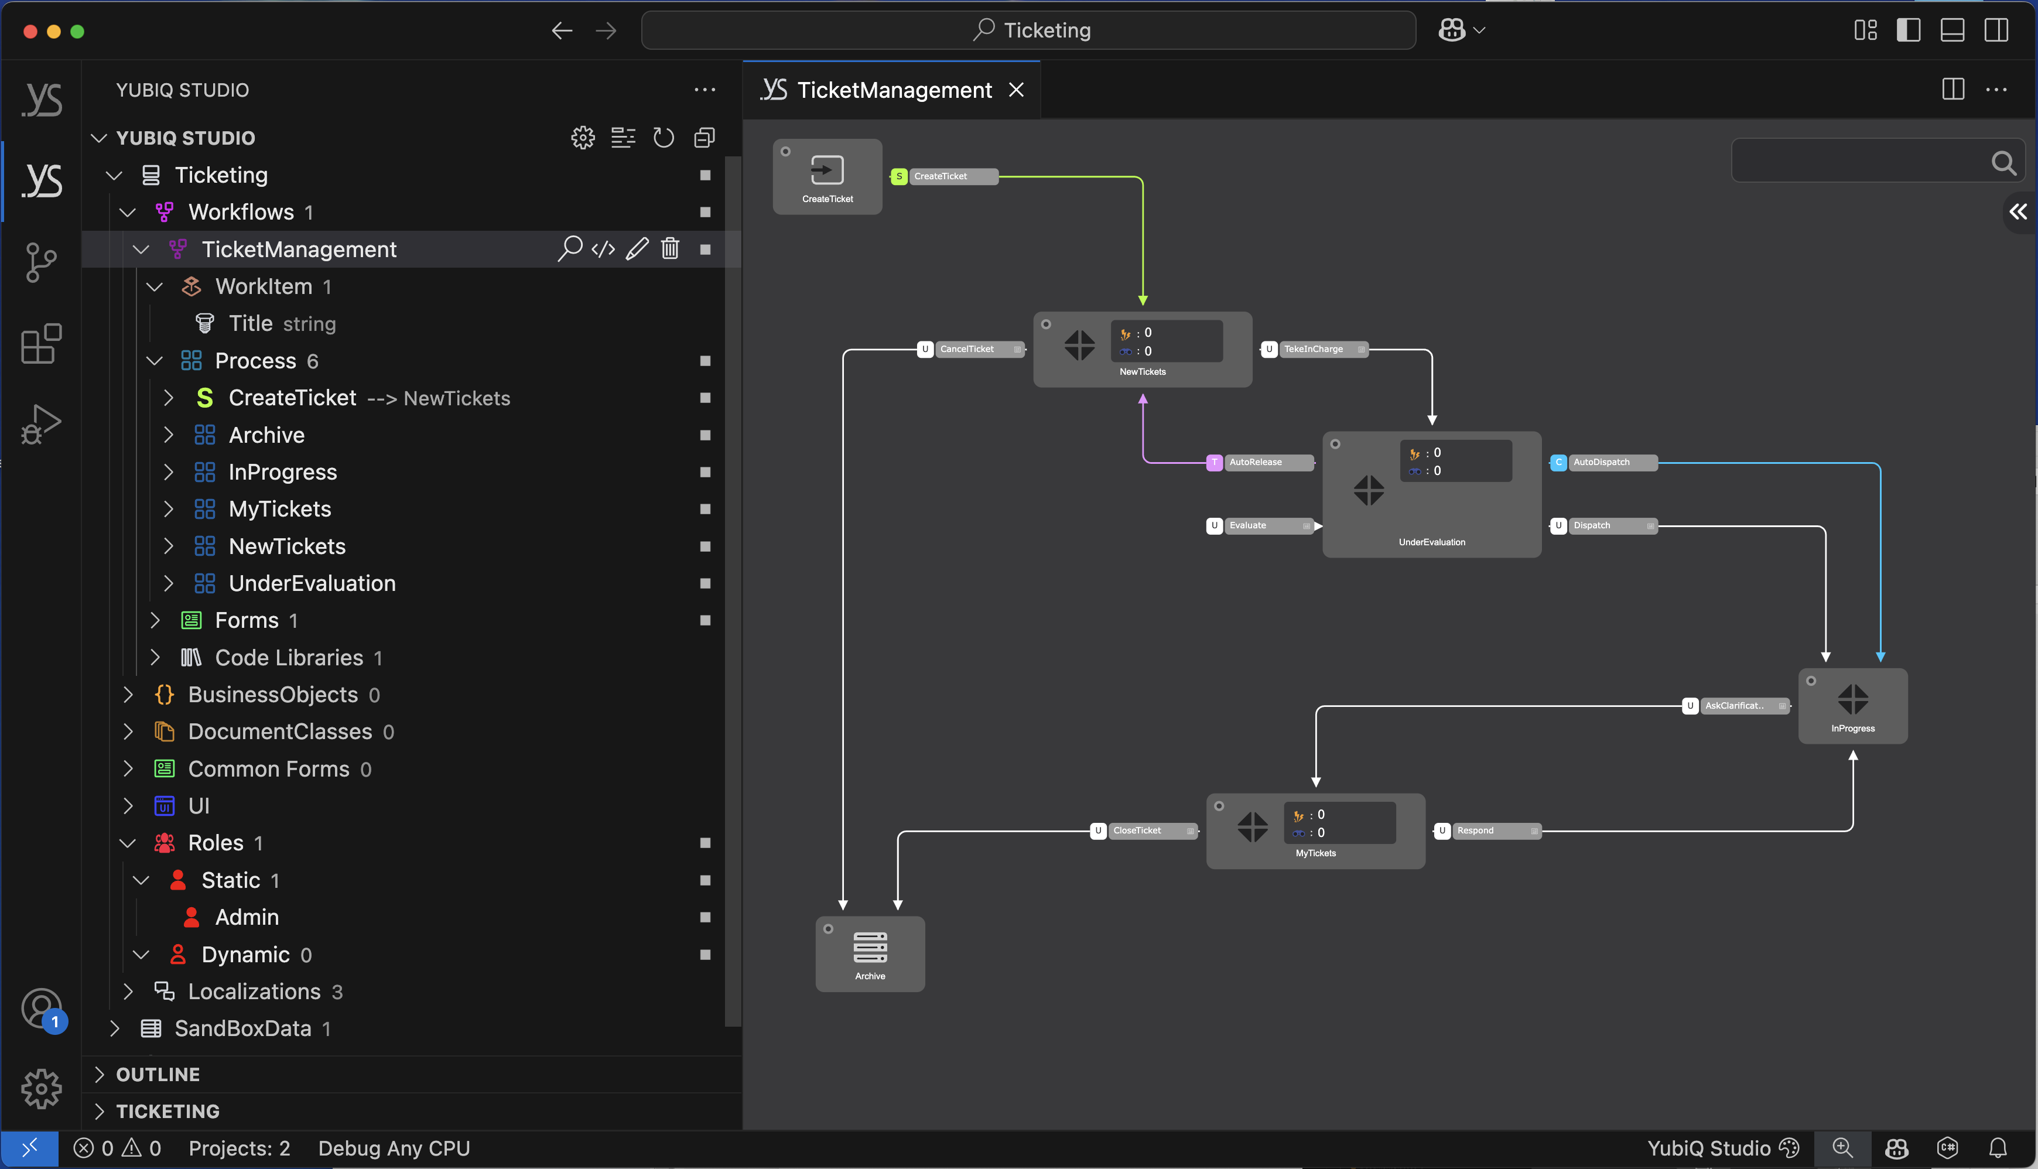
Part 5 : First Modelling :: Actions
Create Action TakeInCharge between NewTicket e UnderEvaluation (User)
Create Action CancelTicket between NewTicket e Archive (User)
Create Action AutoRelease between UnderEvaluation e NewTicket (Timed)
Create Action Evaluate between UnderEvaluation e UnderEvaluation (User)
Create Action Dispatch between UnderEvaluation e InProgress (User)
Create Action AutoDispatch between UnderEvaluation e InProgress (Conditional)
Create Action AskClarification between InProgress e MyTickets (User)
Create Action Respond between MyTickets e InProgress (User)
Create Action CloseTicket between MyTickets e Archive (User)
Create Action ToBeContinue between InProgress e MoreStages (User)
Create Action ToArchive between MoreStages e Archive (Timed)
Click the starting Stage
Hold Shift key
Select the destination Stage

Slide 20
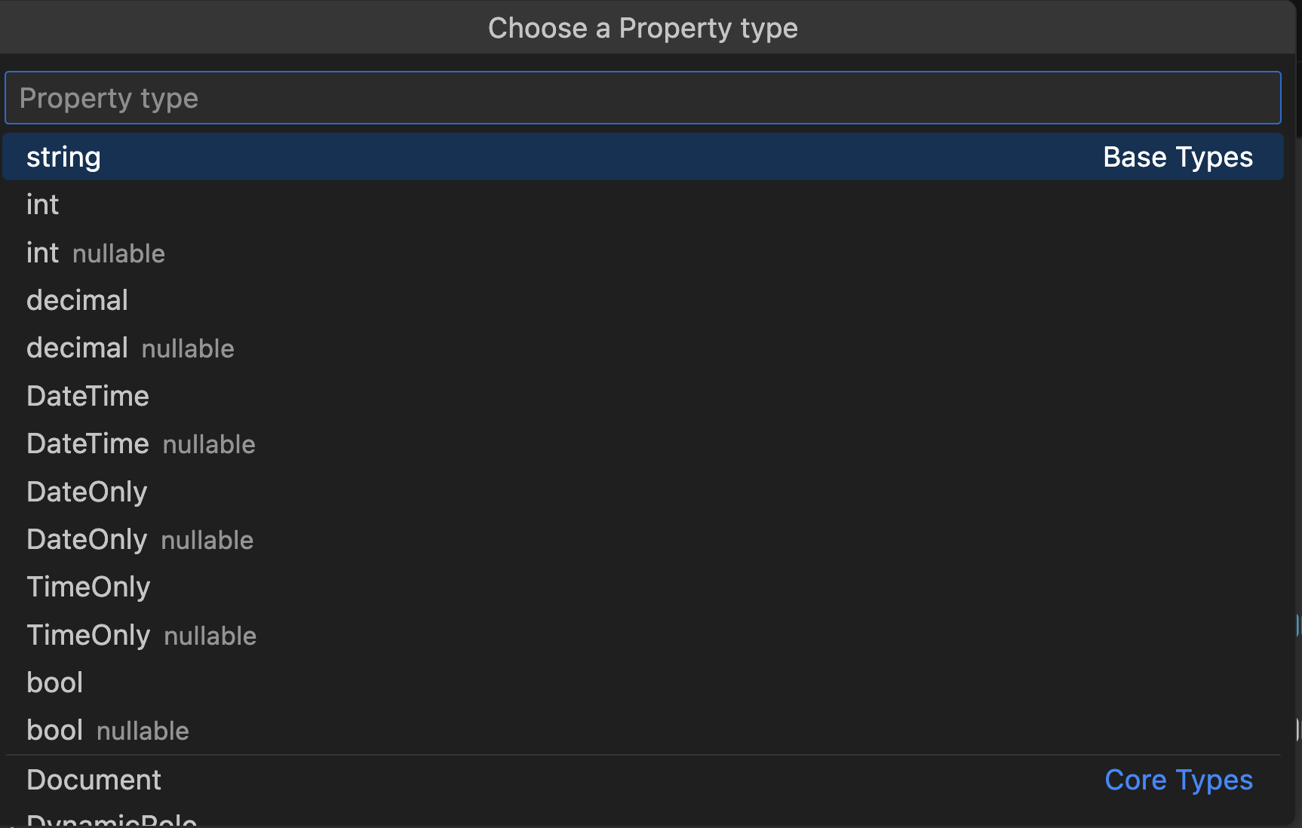
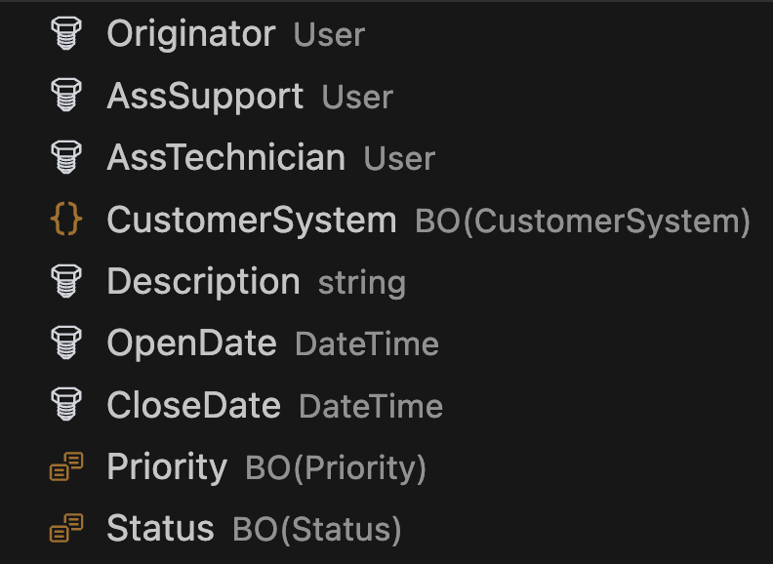
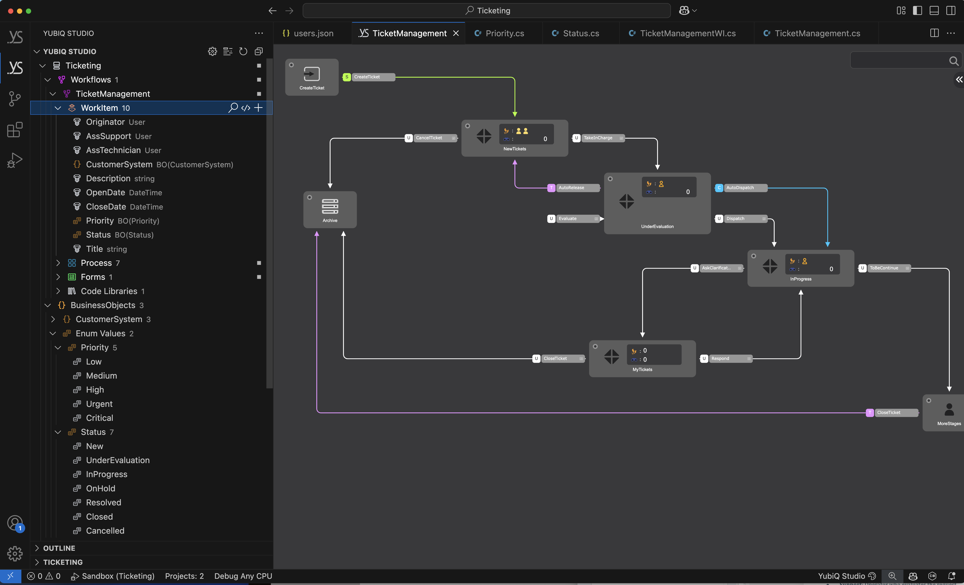
Part 5 : First Modelling :: WorkItem
You need to create a User field for each one of the Dynamic roles created. With the same name
On the WorkItem branch hit + to create all the necessary case fields.
Keep in mind that we need to create the simple Enum structure for Priority and Status in advance

Slide 21
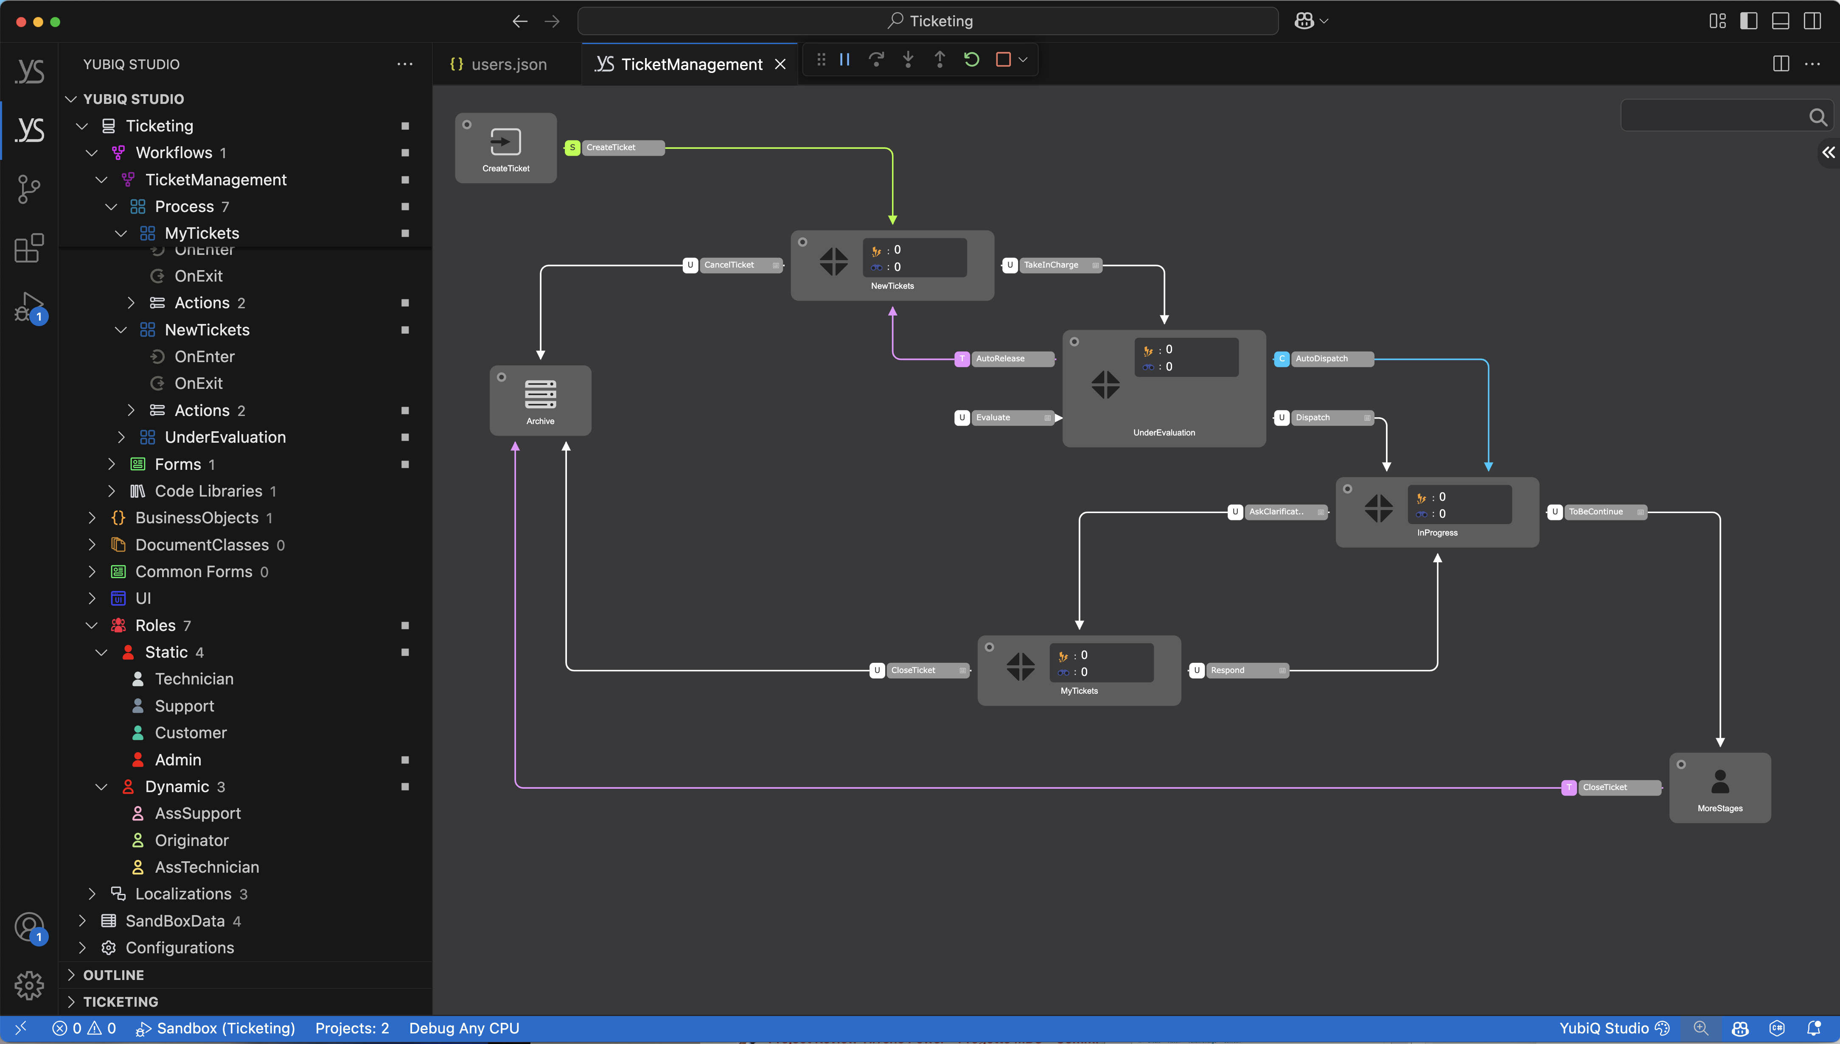
Part 5 : First Modelling :: Assign Roles
Assign Customer to Action CreateTickets
Assign Originator to Stage NewTickets
Assign Support to Stage NewTickets
Assign Originator to Action CancelTicket
Assign Support to Action TakeInCharge
Assign AssSupport to Stage UnderEvaluation
Assign AssTechnician to Stage InProgress
Assign Originator to Stage MyTicket
We left the Stage MoreStage to Admin
Select the Role
Start dragging
Press Shift key
Move to the Action or Stage
Release Shift key

Slide 22
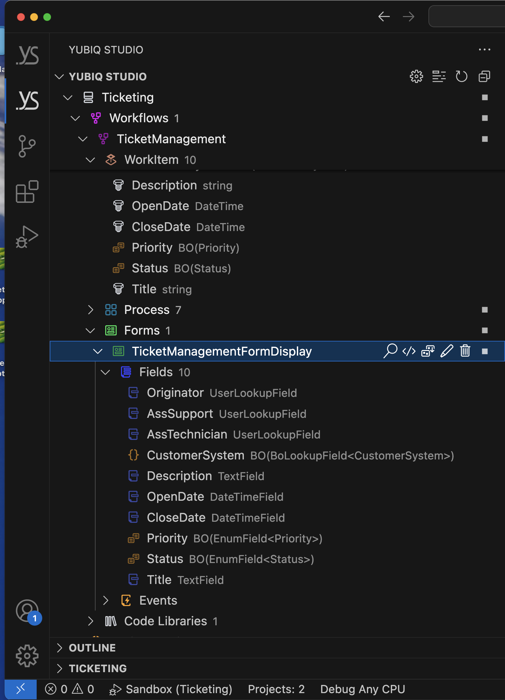
Part 5 : First Modelling :: Form (Display)
Select the Form
Open the Fields branch
Import all the WorkITem Fields

Slide 23
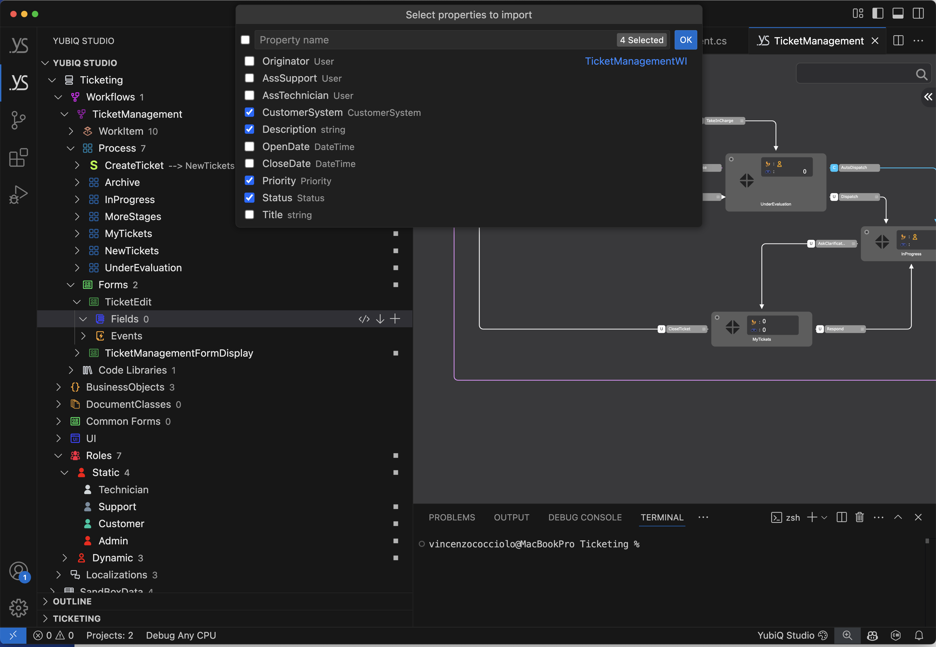
Part 5 : First Modelling :: Form (TicketEdit)
Go to the Forms branch of the given Process
Create a ne Form “TicketEdit”
Import the selectedWorkITem Fields
Drag the Form to the “CreateTicket” Action

Slide 24
Part 5 : First Modelling :: Assign Forms
Assign TicketEdit Form CreateTickets Action
Assign TicketManagementFormDisplay Form to all the Stage
Select the Form
Start dragging
Press Shift key
Move to the Action or Stage
Release Shift key

Slide 25
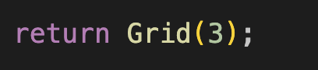
Part 5 : First Coding
CreateTicket Action for OnExecute event
CustomerSystem BusinessObject DescriptionProperties attribute
TicketManagementDisplayForm Form Layout event
NewTicket Action

